Slide 1
Polarization of Light, Entanglement
and
Bell’s Inequality
AJOY GHATAK
ajoykghatak@gmail.com
Professor Asoke Nath Mitra Memorial Meeting
April 14-15, 2025

Slide 2
My sincere thanks to Dr Aalok Misra and Dr Gargi Mitra for asking me to deliver a talk to this distinguished audience

Slide 3
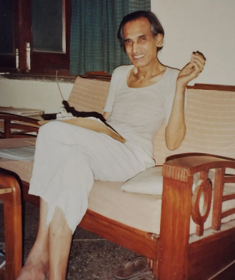
My deep respect to
Professor Asoke Nath Mitra:
an outstanding physicist and a remarkably simple human being

Slide 4
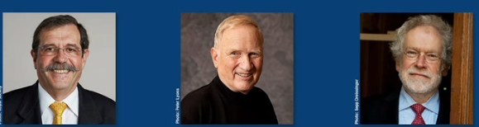
The 2022 Nobel Prize in Physics was awarded to
Alain Aspect John Clauser & Anton Zeilinger
for experiments with entangled photons, establishing the violation of Bell inequalities and pioneering quantum information science

Slide 5
I will give an elementary talk on
experiments with entangled photons, establishing the violation of Bell inequalities

Slide 6
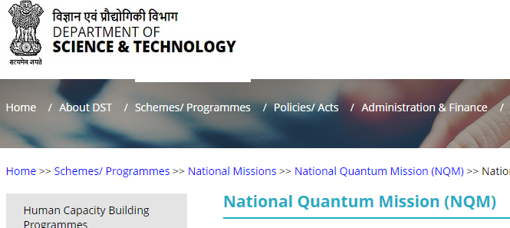

Slide 7
Understanding of experiments with entangled photons, establishing the violation of Bell inequalities .. are topics of great importance

Slide 8

The question
What is Light ?
has intrigued mankind ever since he could see

Slide 9
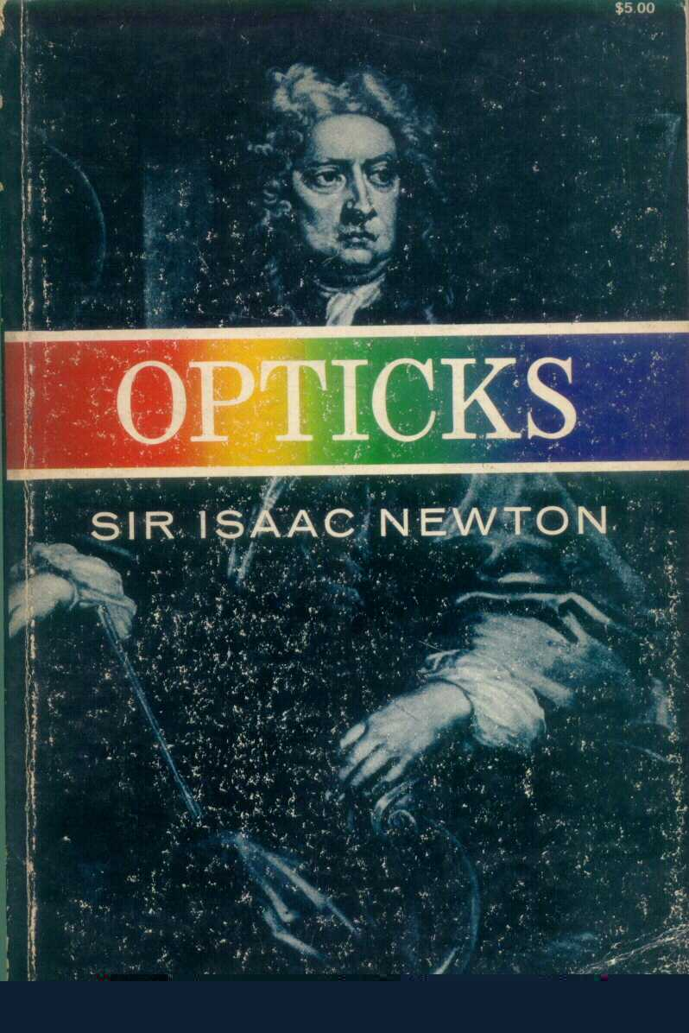
Isaac Newton in his book on
OPTICKS (1687)
had put forward the corpuscular model of light
y
p₁
θ₁
x
θ₂
p₂
Snell’s Law
Refraction of a corpuscle

Slide 10
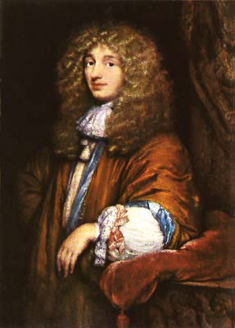
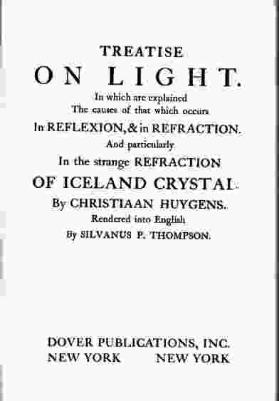
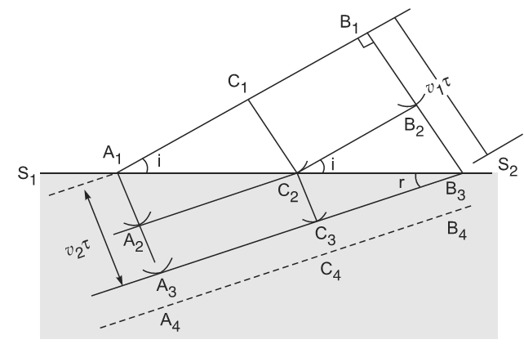
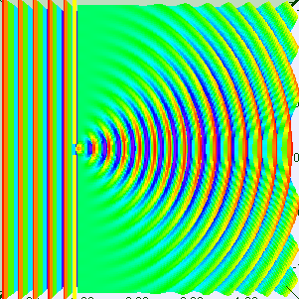
Around 1650, Christiaan Huygens put forward the wave theory of light.
Animation by Mr Wee Loo Kang Lawrence and Mr Fu-kwun Hwang, author of EJSS 5.0 Francisco Esquembre; used with their kind permission.

Slide 11
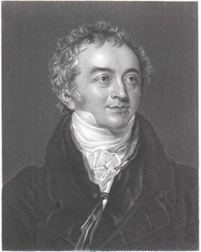
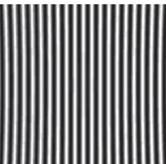
Thomas Young’s Experiment (1801)
Light + Light produce darkness

Slide 12
Thomas Young’s Experiment (1801)
d

Slide 13
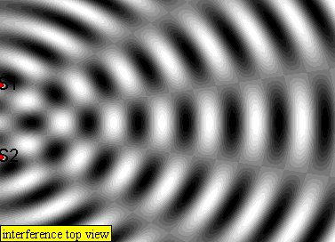
The interference experiment proved that light was a wave but how could it propagate through vacuum??
Lookang http://en.wikipedia.org/wiki/Ripple_tank

Slide 14
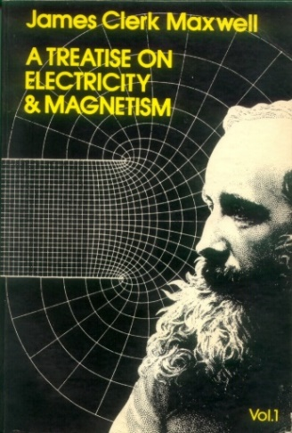
In free space
Displacement Current
Faraday’s Law

Slide 15
In free space

Slide 16
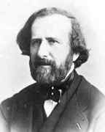
The above value was very close to the value of the speed of light measured by Fizaeu (in 1849) which was about
318 million meters/s.

Slide 17
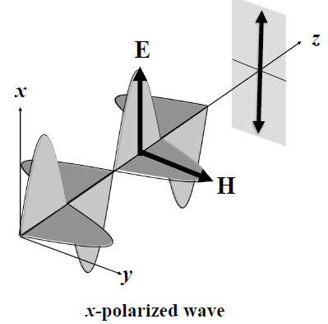
Around 1864 Maxwell predicted the existence of electromagnetic waves and said
light itself is an electromagnetic wave

Slide 18
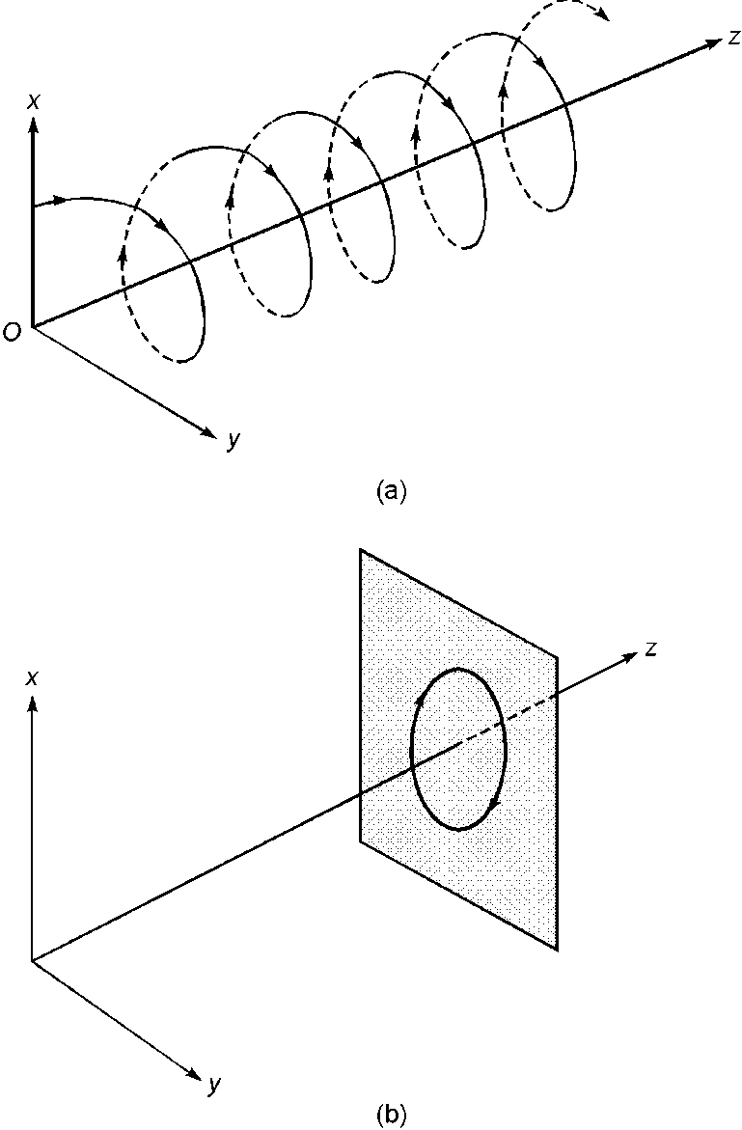
z
x
O
RCP
y
x
z
O
y
Circularly Polarized Wave

Slide 19
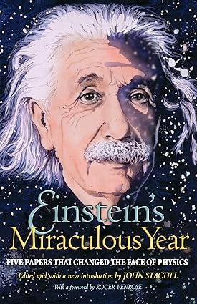
1905: Einstein’s Year of Miracles
FIVE PAPERS THAT CHANGED THE FACE OF PHYSICS
(Editor John Stachel)

Slide 20
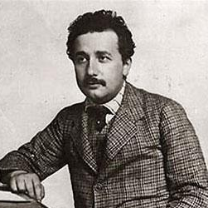
In the second paper in his Year of Miracles, Einstein wrote radiation energy consists of indivisible quanta of energy

Slide 21
In 1926, Einstein’s Light Quantum came to be known as Photon

Slide 22
x
Unpolarized light
y
θ
P₁
z
P₂
Law of Malus

Slide 23
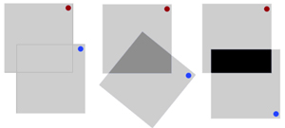

Slide 24
x
Single photon source
y
θ
P₁
z
P₂
Probability of passing through

Slide 25
x
Single photon source
y
θ
P₁
z
P₂
Probability of passing through

Slide 26
x
x
o(s)
z
y
y
e( f )
LCP
Calcite
QWP
A linearly polarized beam making an angle 45° with the y-axis gets converted to a LCP after propagating through a calcite QWP.

Slide 28
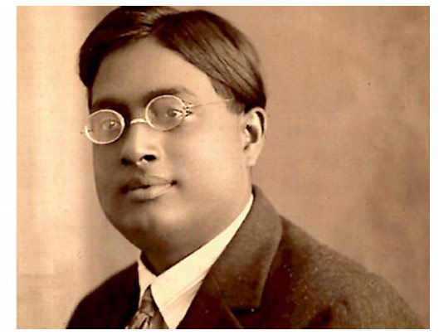
Satyendra Nath Bose

Slide 29
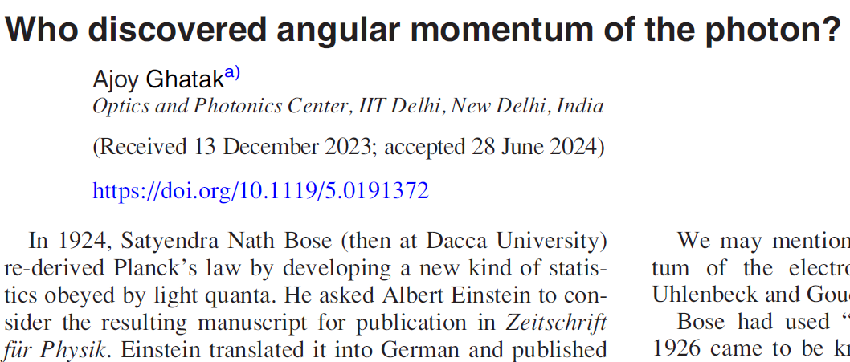
American Journal of Physics
LETTERS TO THE EDITOR | AUGUST 01 2024
Ajoy Ghatak
Am. J. Phys. 92, 567 (2024)
https://doi.org/10.1119/5.0191372

Slide 31
Double refraction in calcite
Photograph courtesy Professor V Lakshminarayanan and adapted from G. Ropars, A. Le Flocha and V. Lakshminarayanan, The sunstone and polarised skylight: ancient Viking navigational tools ?, Contemporary Physics (2014).

Slide 32
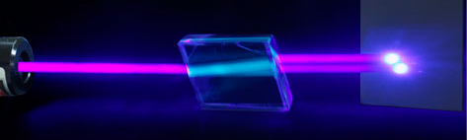
Double refraction in calcite
When an unpolarized light beam is incident normally on a calcite crystal, it usually splits up into two linearly polarized beams.

Slide 33
Double refraction in calcite
When an unpolarized light beam is incident normally on a calcite crystal, it usually splits up into two linearly polarized beams.
Photograph courtesy Professor V Lakshminarayanan and adapted from G. Ropars, A. Le Flocha and V. Lakshminarayanan, The sunstone and polarised skylight: ancient Viking navigational tools ?, Contemporary Physics (2014).

Slide 34

Polaroid
x
x-polarized beam
.
z
y
Sodium Lamp
45 degree polarized
beam
Calcite
y-polarized beam
x-y device

Slide 35
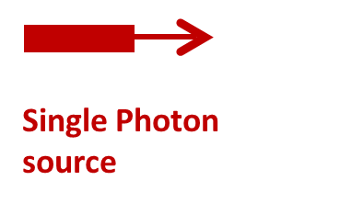
Polaroid
x
x-polarized beam
.
z
y
45 degree polarized
photons
Calcite
y-polarized beam
x-y device

Slide 36
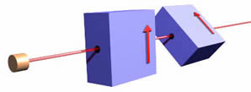
x
u
u
x
v
v
y
y
u-v device
z
x-y device
Adapted from http://www.upscale.utoronto.ca/PVB/Harrison/BellsTheorem/BellsTheorem.html

Slide 37
x
x
x
u
v
y
θ
x-y device
u-v device
device
x
u
v
y

Slide 38
x-polarized
x
y
x
y
x-y device
x-y device
y-polarized
Coincidence

Slide 39
According to quantum theory:
the polarization of the photon (traveling to the left – or to the right) is not known before one of them is measured;

Slide 40
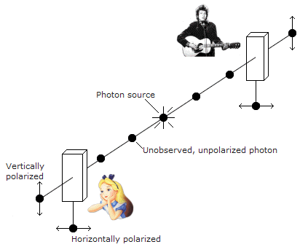
If the photon going to the left is passed through an x-y device, and it is found to be x-polarized then the photon going to the right collapses to a state in which its polarization state is y-polarized
x-y device
x-y device
Diagram adapted from http://www.faculty.umb.edu/gary_zabel/Courses/Parallel%20Universes/Texts/Quantum%20Entanglement.htm
(Based on a diagram from the book Quantum Enigma)

Slide 41
Similarly, if the photon going to the left is passed through an u-v device, and it is found to be u- polarized then the polarization of the photon going to the right collapses to a state in which its polarization state is for sure v - polarized.
u-v device
u-v device
Diagram adapted from http://www.faculty.umb.edu/gary_zabel/Courses/Parallel%20Universes/Texts/Quantum%20Entanglement.htm
(Based on a diagram from the book Quantum Enigma)

Slide 42
Whatever happened to one particle would thus immediately affect the other particle, wherever in the universe it may be. Einstein called this
Spooky action at a distance

Slide 43
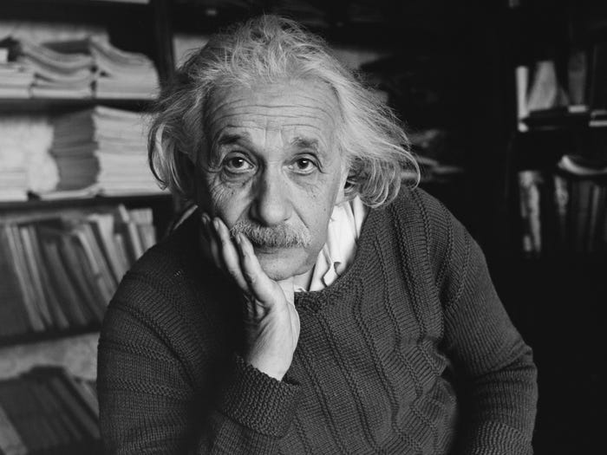
Whatever happened to one particle would thus immediately affect the other particle, wherever in the universe it may be. Einstein called this
Spooky action at a distance
In German, Einstein said
Spukhafte Fernwirkung

Slide 44
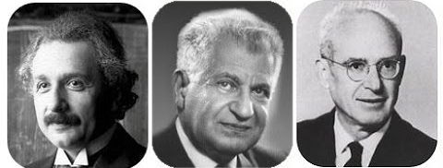
In 1935 Einstein, Podolsky & Rosen wrote in a paper
If quantum theory was correct, then two particles (which are millions of kilometers apart) can be entangled in the sense that by determining a property of one of the particles, the property of the second particle can be instantaneously changed.
And special theory of relativity forbids the transmission of any signal faster than the speed of light.
This came to be known as The EPR Paradox.

Slide 45
About thirty years later, experiments confirmed the predictions of quantum mechanics namely Einstein's impossible proposition was in fact correct:
instantaneous changes in widely separated systems did occur

Slide 46
EPR argued that, if without in any way disturbing a system, we can predict with certainty (i.e., with probability equal to unity) the value of a physical quantity, then the second particle must have possessed the measured property before the measurement was carried out.

Slide 47
We assume that the photon must carry all the information; thus there must exist “hidden variables” so that we can assign values of all observables of a system.
x- polarized photon
v- polarized photon
x-y device
u-v device
y- polarized photon
x-y device

Slide 48
Photons going Photons going
to the left to the right

Slide 49
Let us calculate

Slide 50
Photons going Photons going
to the left to the right

Slide 51
Photons going Photons going
to the left to the right

Slide 52
We next calculate

Slide 53
Photons going Photons going
to the left to the right

Slide 54
Photons going Photons going
to the left to the right

Slide 55
Photons going Photons going
to the left to the right

Slide 58
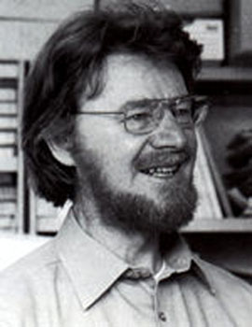
This is a simple form of Bell’s inequality
John Stewart Bell (1928 – 1990) was an outstanding Irish physicist, and the originator of Bell's Theorem, one of the most important theorems in quantum physics.

Slide 59
x-polarized
x
y
u
x
v
θ
y
u-polarized
x-y device
According to quantum theory
u-v device

Slide 60
Now, according to Quantum Mechanics
u
x
v
z
y
u-v device

Slide 61
Now, according to Quantum Mechanics
x
u
x
v
y
z
y
device
u-v device

Slide 62
Now, according to Quantum Mechanics
x
u
x
v
y
z
y
device
u-v device
Therefore Bell’s inequality
will imply

Slide 63
Thus, according to Quantum Theory, Bell’s inequality will imply
If we assume
the above inequality will imply

Slide 64
Thus quantum theory and Bell’s inequality are not compatible which implies that either quantum theory is right or theory based on hidden variables, but not both.

Slide 65

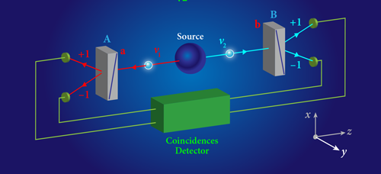
An apparatus for performing a Bell test. A source emits a pair of entangled photons ν1 and ν2. Their polarizations are analyzed by polarizers A and B (grey blocks), which are aligned, respectively, along directions a and b (a and b can be along x, y or any direction in the x-y plane; here, they are along x.)
Adapted from:Alain Aspect, Physics 8, 123, Dec 16, 2015.

Slide 66
Aspect etal write:
The linear-polarization correlation of pairs of photons emitted in a radiative cascade of calcium has been measured. The new experimental scheme, using two-channel polarizers is a straightforward transposition of EPR gedanken experiment. The present results, in excellent agreement with the quantum mechanical predictions, lead to the greatest violation of Bell's inequalities ever achieved.

Slide 67
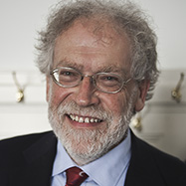
Bell’s theorem represents (to quote Anton Zeilinger)
…as one of the most profound discoveries since Copernicus… Bell delivered a death blow to the local realistic picture of the world. .. many experiments have demonstrated that the predictions of quantum mechanics for entangled particles are fully correct … and the world is really as “crazy” as predicted by quantum mechanics.

Slide 68
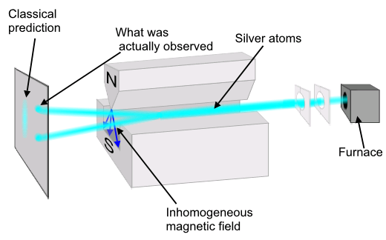
Diagram drawn by en wikipedia Theresa Knott. http://en.wikipedia.org/wiki/Stern_gerlach_experiment

Slide 69
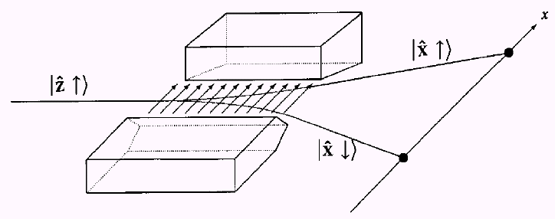

Slide 70
Assume 2 spin half particles in the singlet state
Suppose at t = 0 it dissociates and the two particles go off in opposite directions
2
1

Slide 71
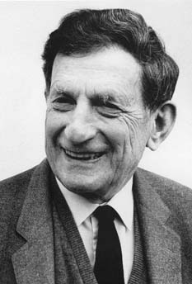
The most fundamental theory now available is probabilistic in form, and not deterministic ..
…David Bohm
David Bohm was widely considered one of the best quantum physicists of all time.

Slide 72
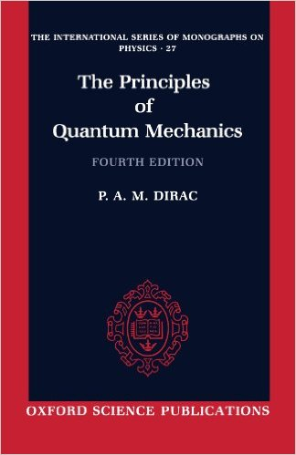
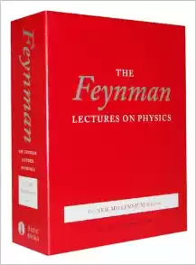
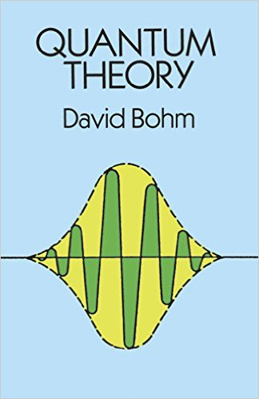
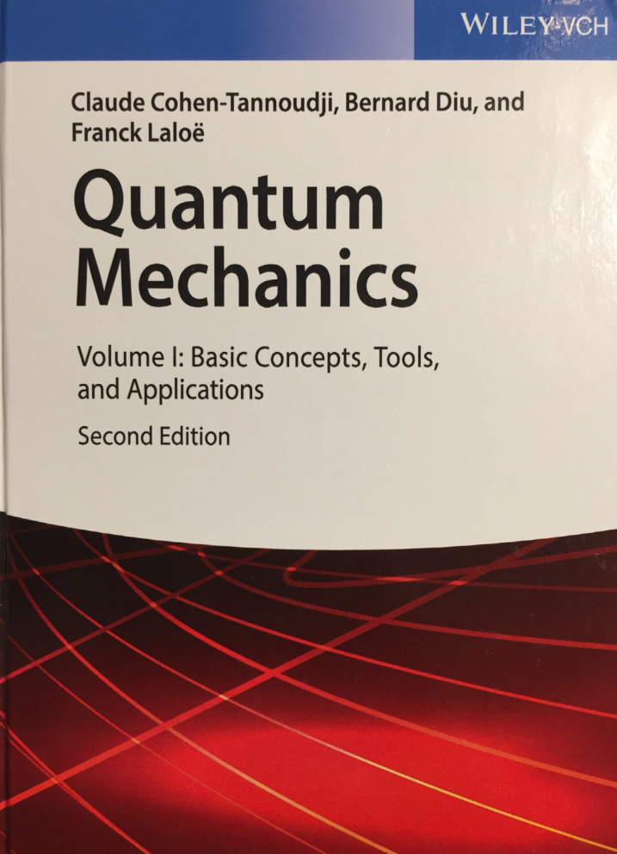
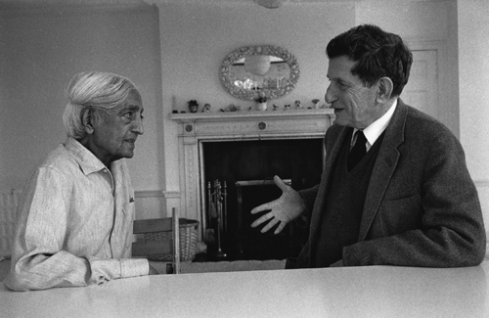
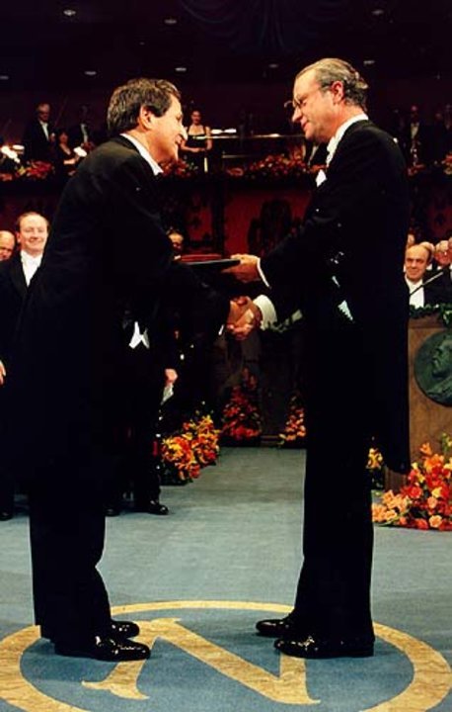

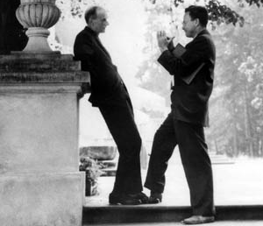
Reference books:
Volume III
Dirac wanted to understand physics by constructing mathematics, while Feynman started from what he observed in the real world.
Translated by
Susan Hemley
Nicole Ostrowsky
& Dan Ostrowsky
Photo by Marek Holzman

Slide 73
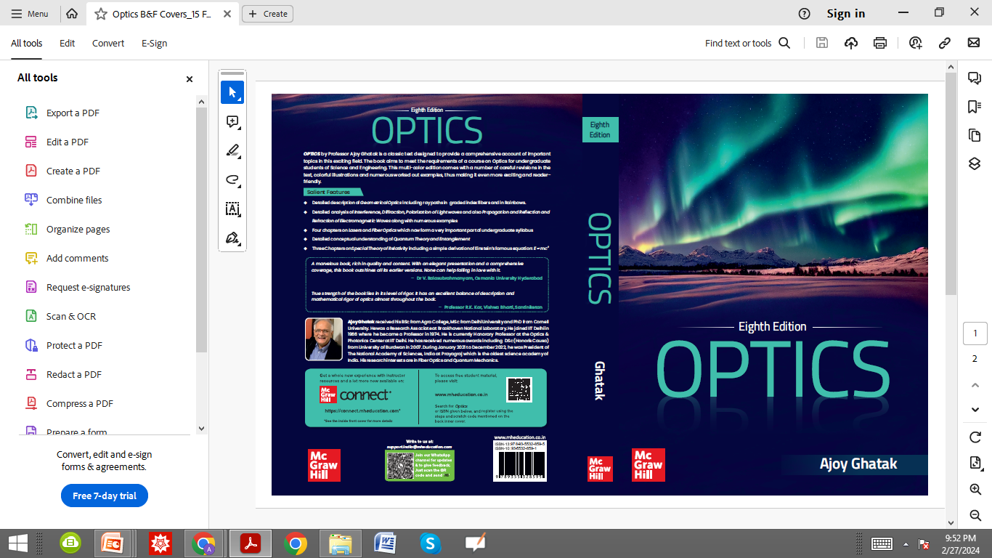
Whatever I have said today is given in
OPTICS, 8th Edition (2024) Ajoy Ghatak,
McGraw-Hill Education (India)

Slide 74
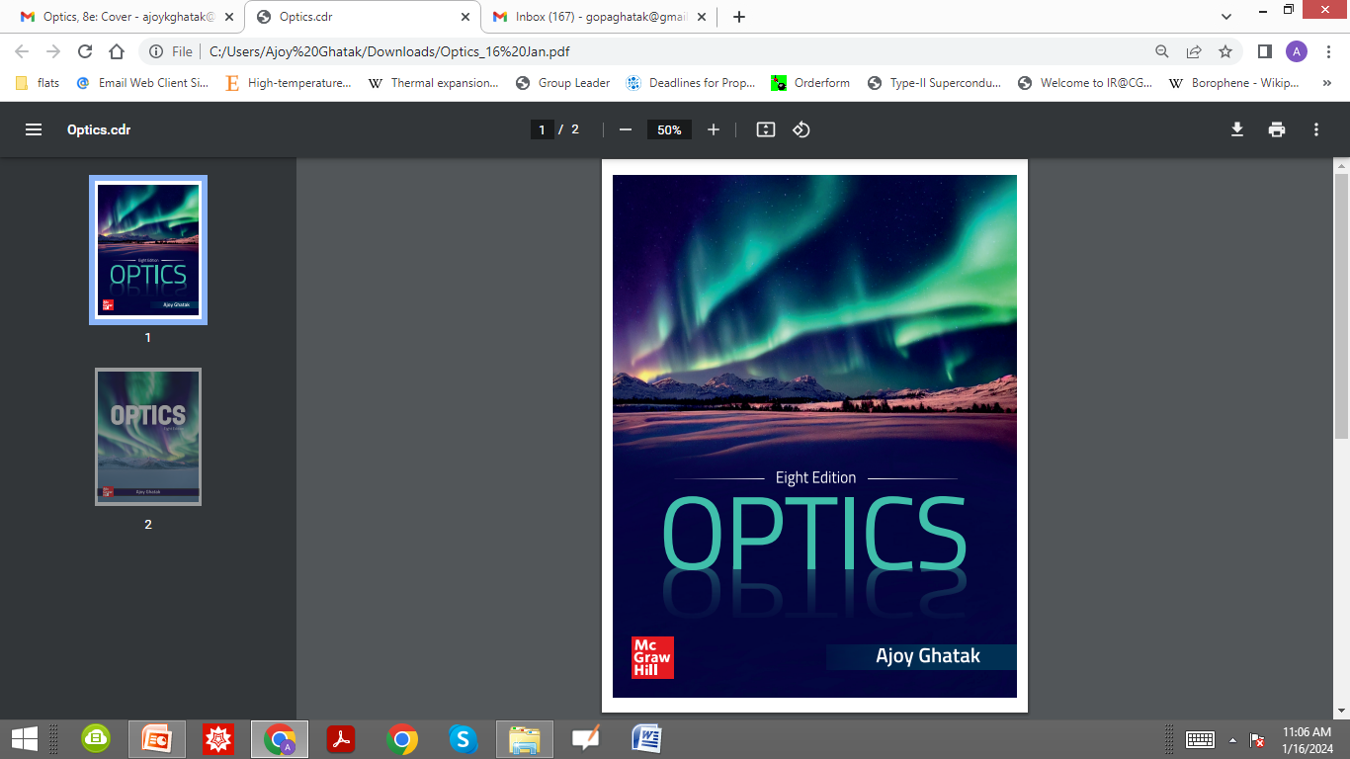
Many thanks for your attention

Slide 75
Many thanks for your attention

Slide 76
The spectacular display of colors in the northern and in the southern hemispheres are called “Aurora Borealis”
The Aurora can be seen near the north and south poles; The colors are caused by the following process: charged particles (emitted by the sun and trapped in the magnetic field near the poles) collide with the atoms and molecules in our atmosphere and the excited atoms and molecules emit light which result in the beautiful display of colors. The green color is primarily due to excitation of oxygen atoms while the purple or pink are caused by excitation of nitrogen atoms.

Slide 77
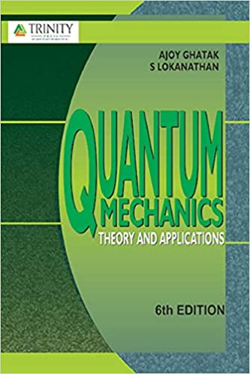
I have discussed the Stern Gerlach experiment in great detail in this book
QUANTUM MECHANICS: Theory & Applications, (2019), 6th Edition, Ajoy Ghatak and S. Lokanathan, Laxmi Publications, Delhi.

